Slide 1
Recent in het nieuws
Al gezien?

Slide 2
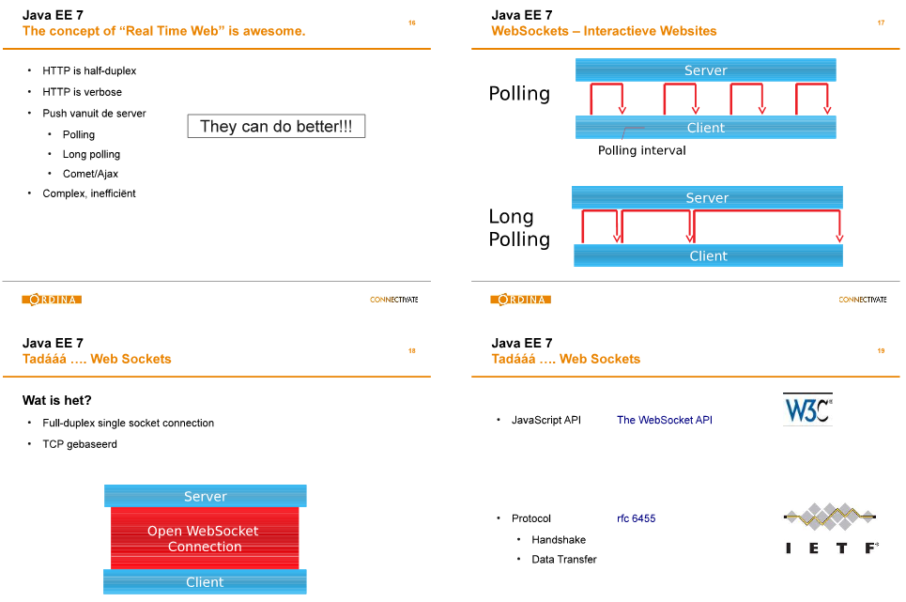
Notes:
Martijn & Jouke JEE7 launch approx. jul 2013: websockets in 8 sheets

Slide 3
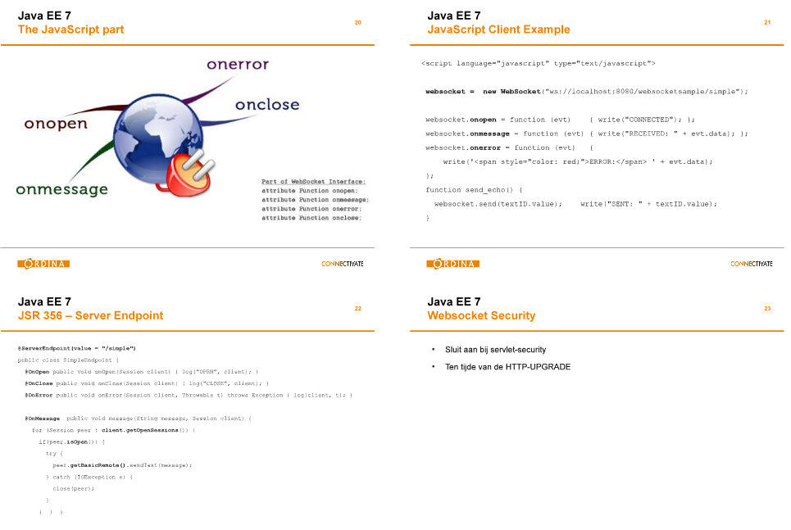

Slide 4

http://www.nljug.org/databasejava/websockets-get-the-web-up-to-speed/

Slide 5
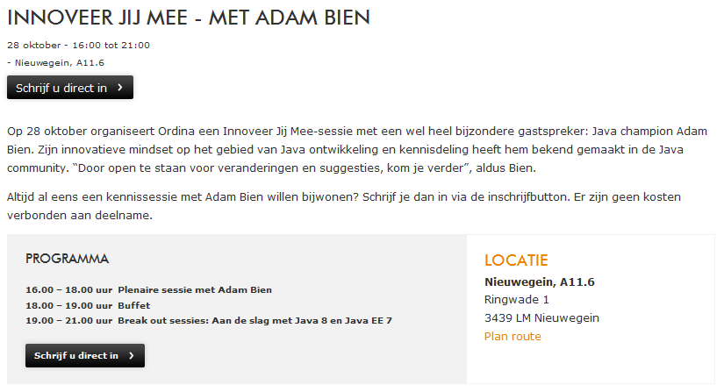
Notes:
Adam Bien okt 2014

Slide 6
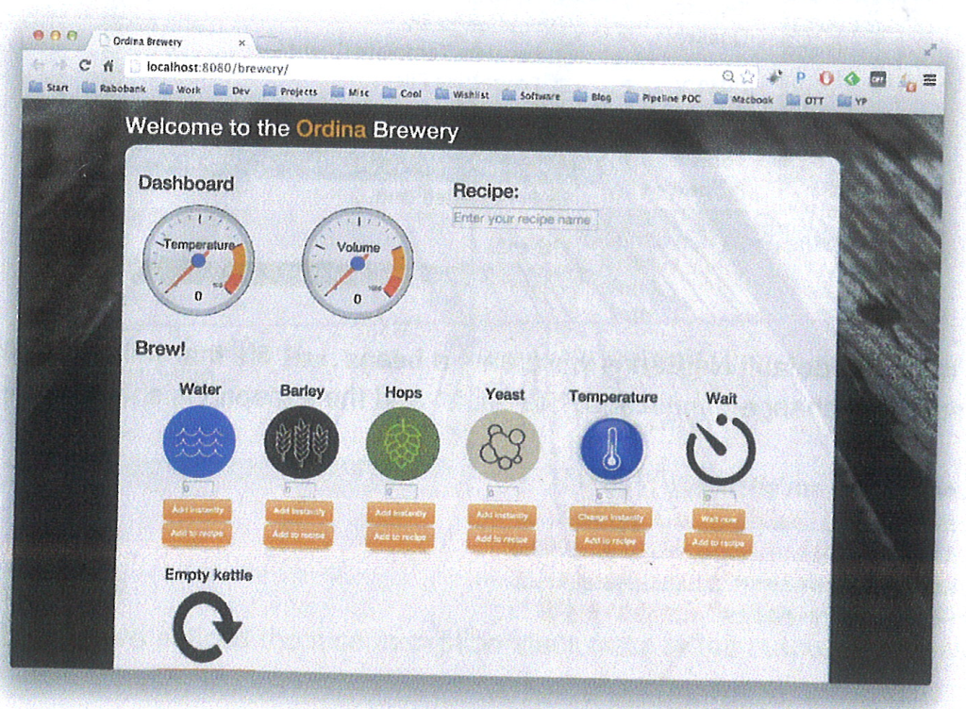
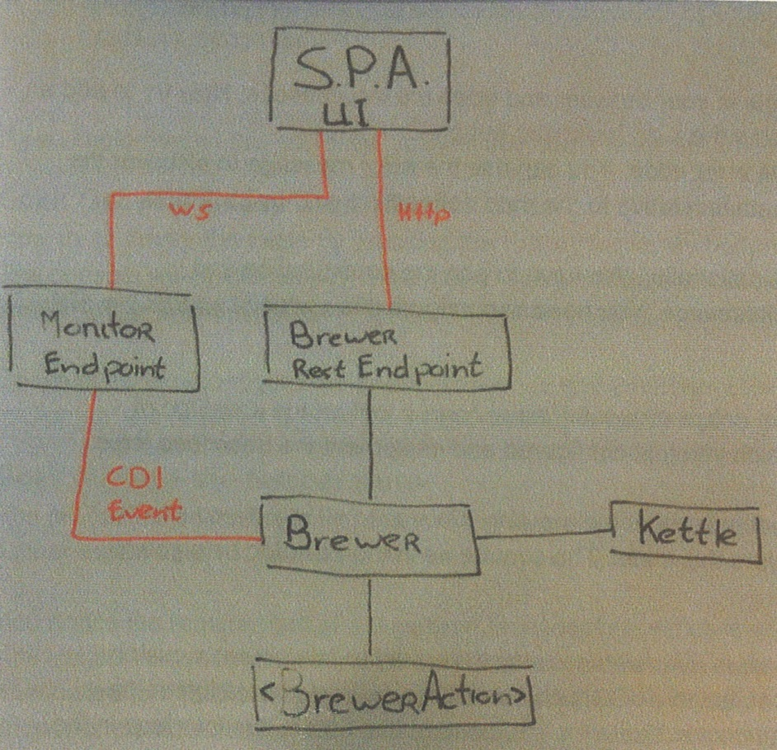
https://github.com/EelcoMeuter/BreweryWorkshop.git
Notes:
Incl. Brewery: ws & JAX-RS (en CDI en JMS)

Slide 7
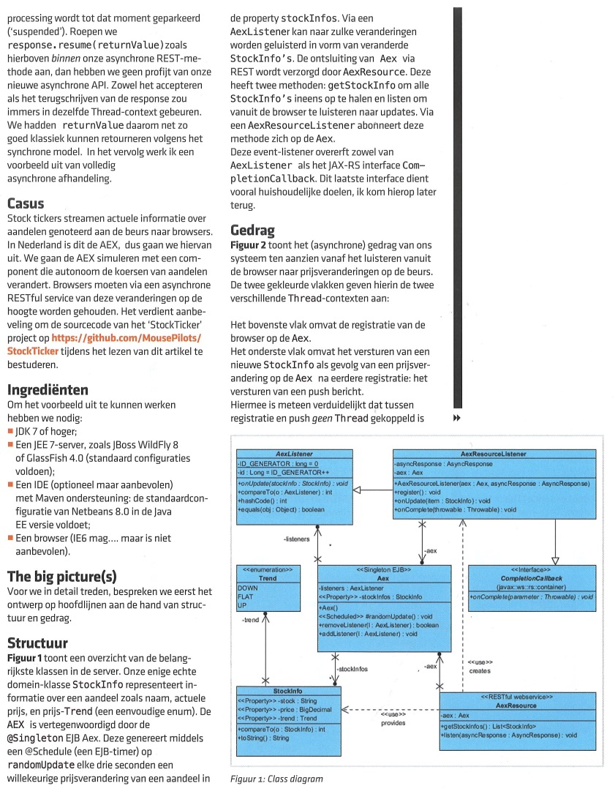
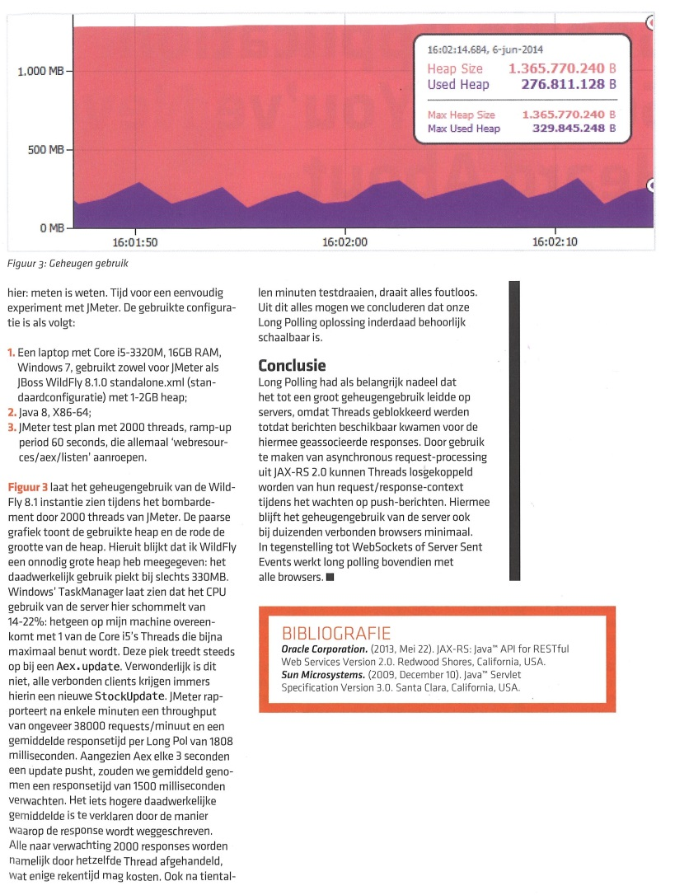
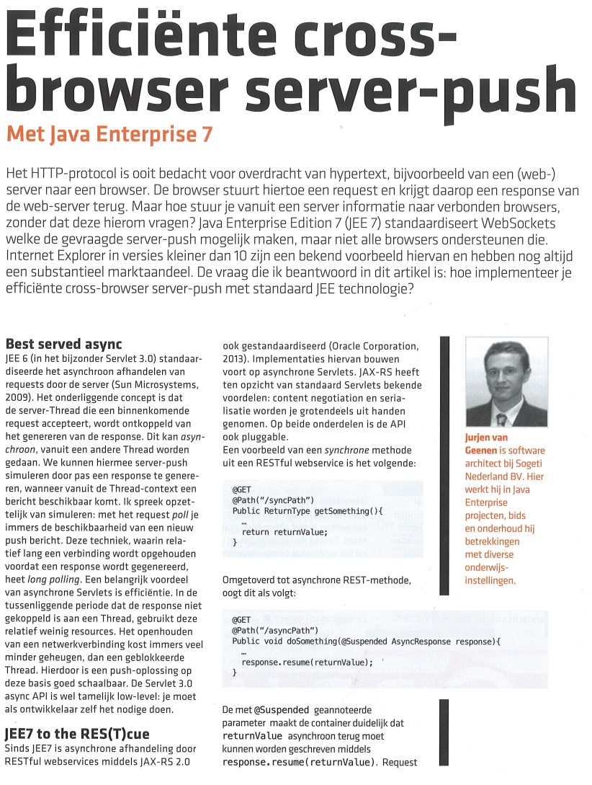
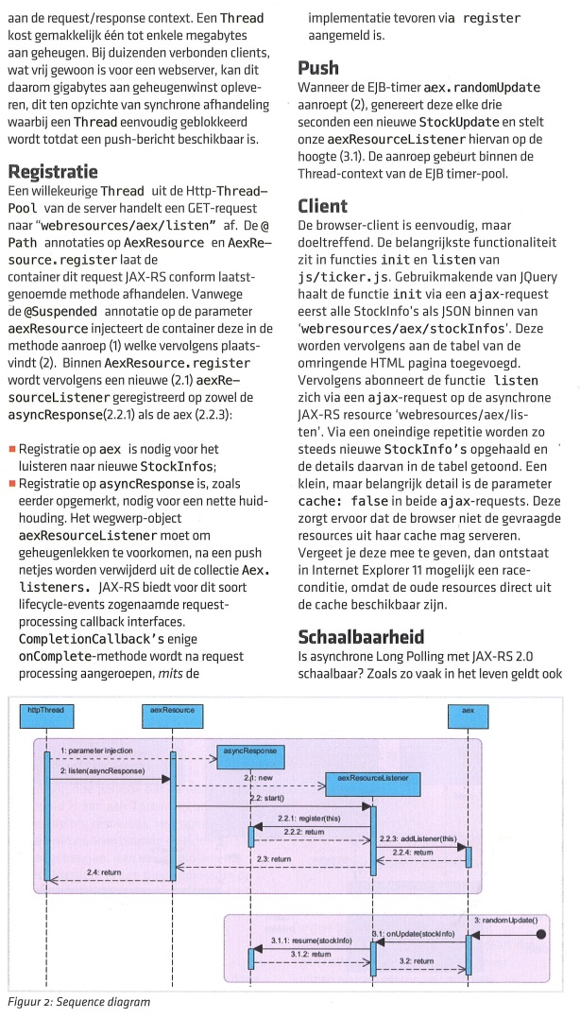
Notes:
NL-JUG mag #5-2014: JAX-RS 2.0 Comet-based long polling

Slide 8
https://github.com/MousePilots/StockTicker.git
// voor eenmalig gebruik in long polling
class AexResourceListener implements CompletionCallback {
@Autowired private final Aex aex;
@Autowired private final AsyncResponse asyncResponse;
public void register() {
asyncResponse.register(this); // voor onComplete()
aex.addListener(this); // voor onUpdate()
}
public void onUpdate(StockInfo item) {
asyncResponse.resume(item);
}
@Override
public void onComplete(Throwable throwable) {
aex.removeListener(this);
}
}
Notes:
.. En belangrijkste code
NL-JUG mag #5-2014

Slide 9
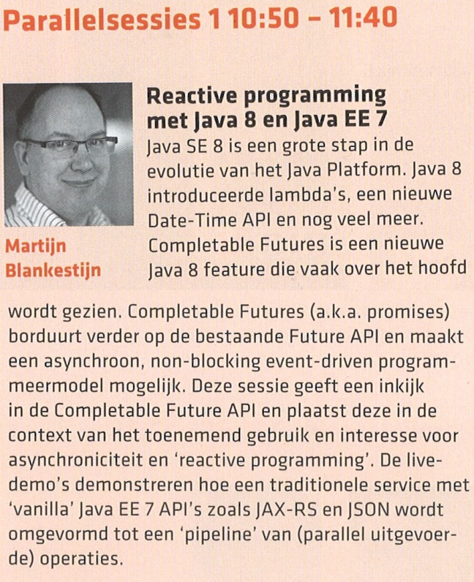

Notes:
J-Fall okt 2014: Martijn B. CompletableFuture (sneak preview: J-Tech PV sep/okt 2014)

Slide 10
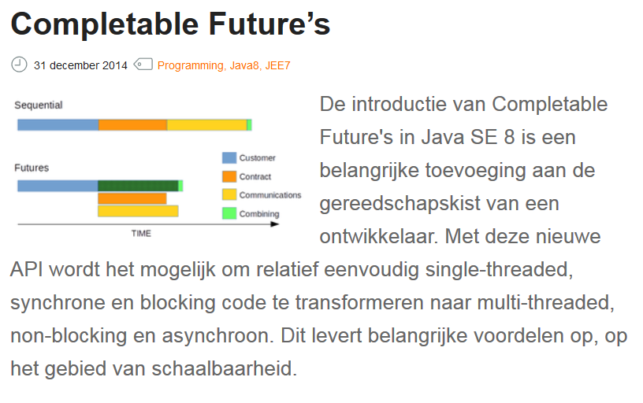
http://www.nljug.org/databasejava/completable-futures/
Martijn Blankestijn, 31 december 2014

Slide 11
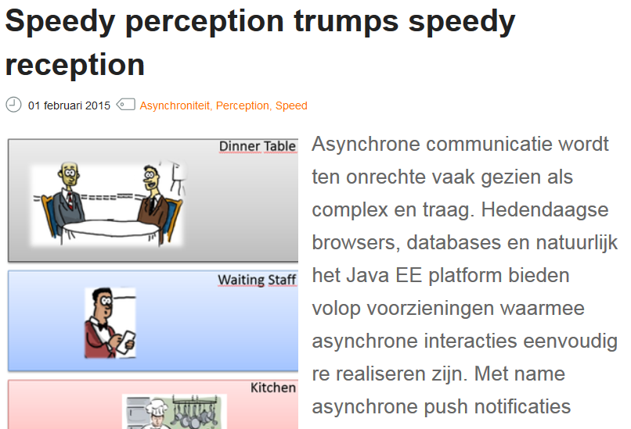
http://www.nljug.org/databasejava/speedy-perception-trumps-speedy-reception/
Lucas Jellema, 01 februari 2015

Slide 12
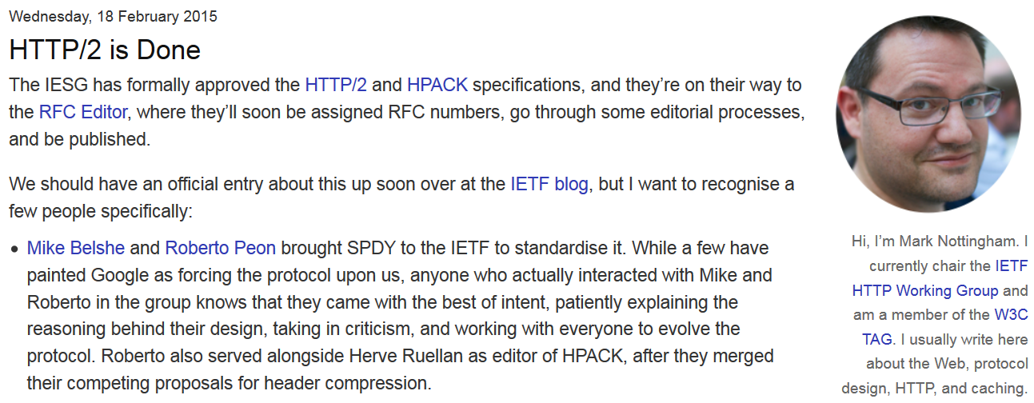
https://www.mnot.net/blog/2015/02/18/http2
Notes:
https://ma.ttias.be/the-http2-spec-is-final/

Slide 13
Devoxx 2015
HTTP/2 for the Web developer - Brian Clozel
Asynchronous programming in Java 8: how to use CompletableFuture - José Paumard
WebRTC Security: is web-based peer-to-peer ready for primetime? - Lieven Desmet
unRESTful Web Services with HTTP/2 - Fabian Stäber
HTTP 2.0 & Java: Current Status - Simone Bordet

